Slide 1
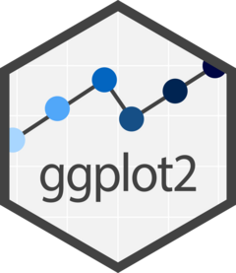

Visualizing Data
in R using ggplot2
Lauren Nichols
Data Visualization Specialist
Center for Data and Visualization Sciences
Lmn7@duke.edu
January 2023

Slide 2
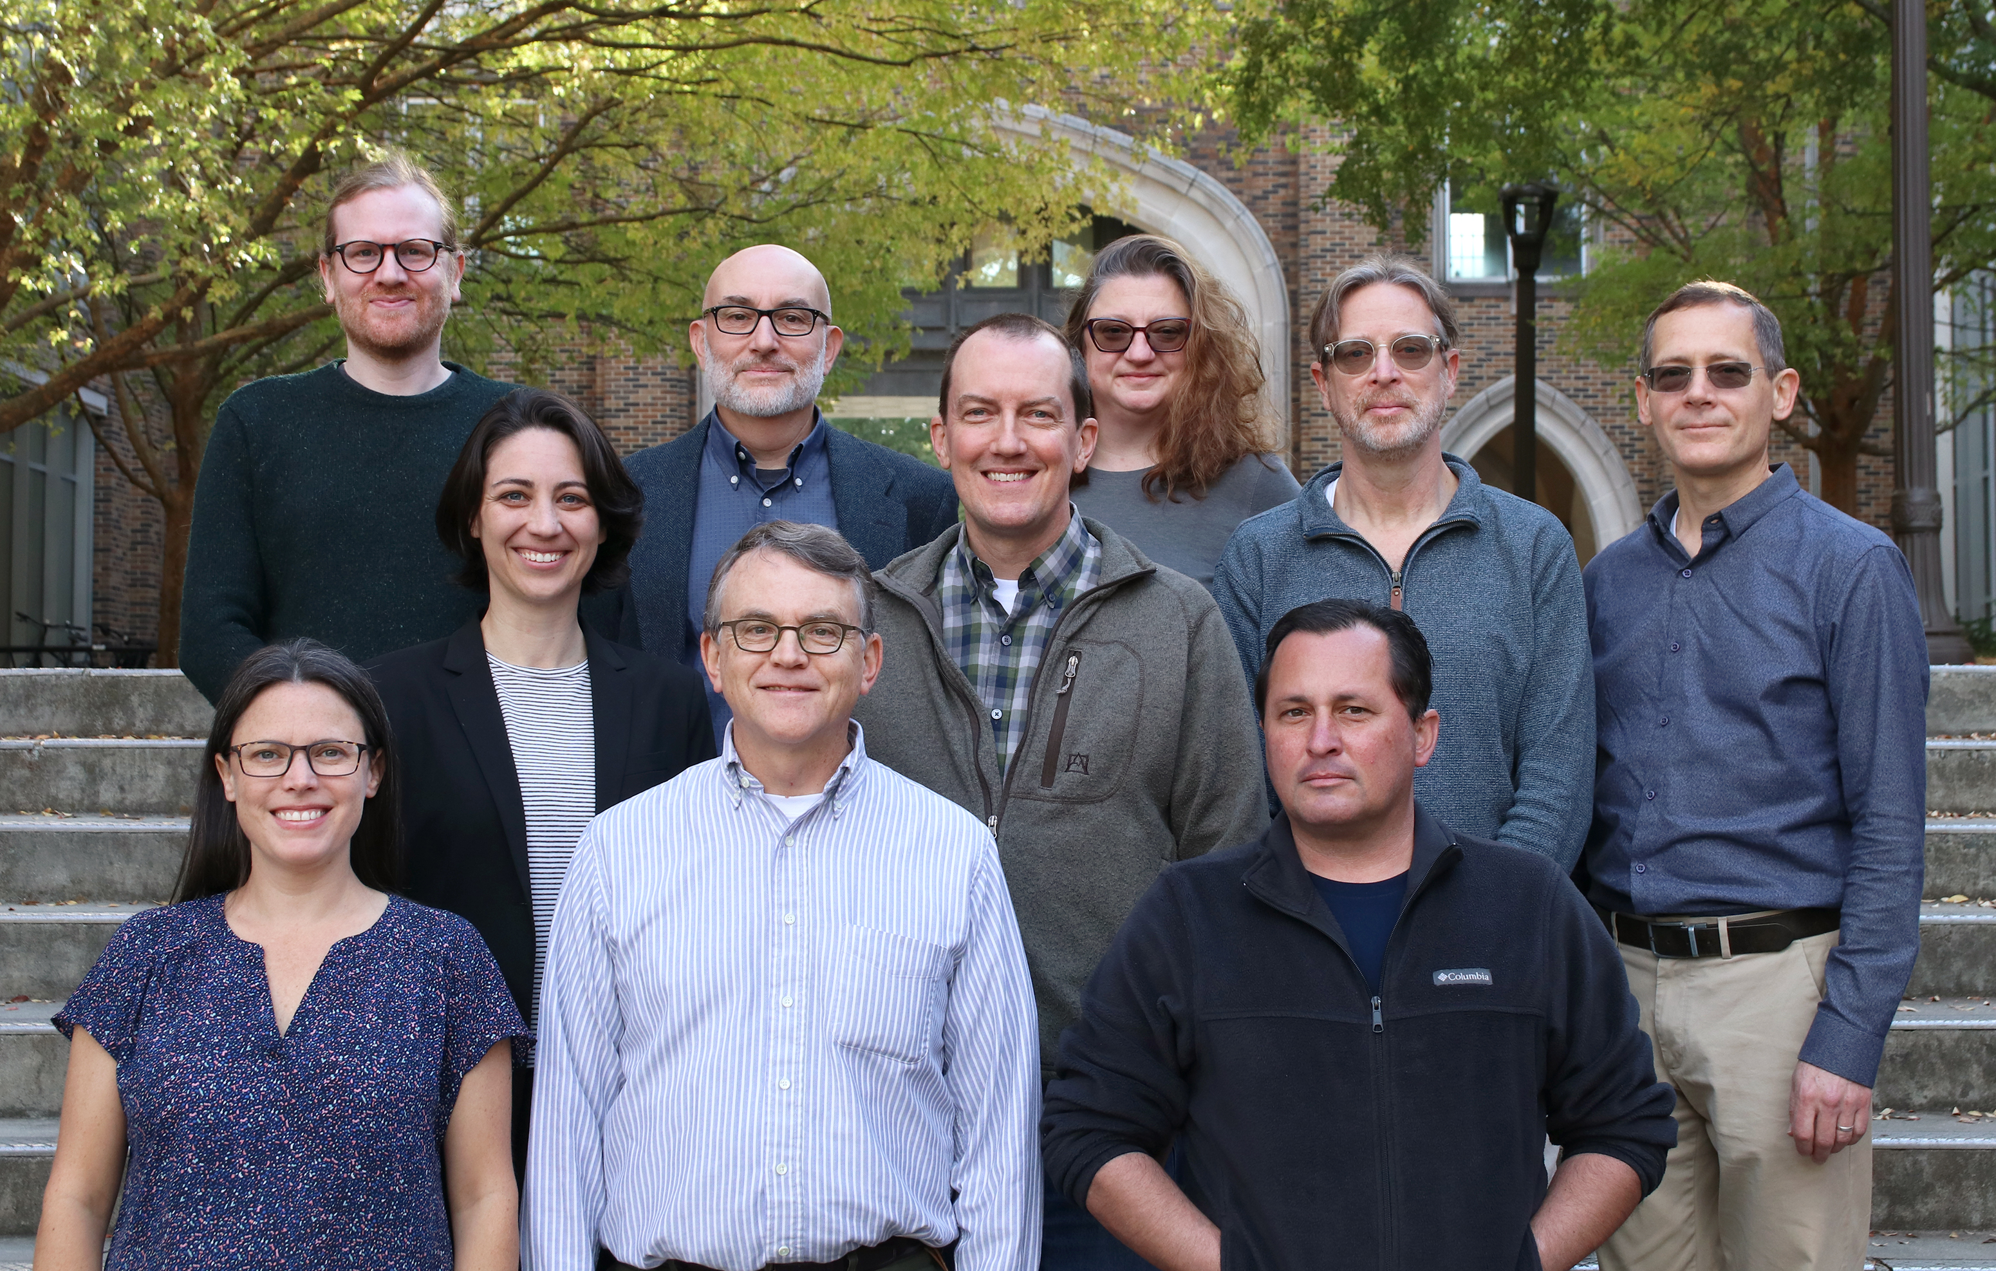
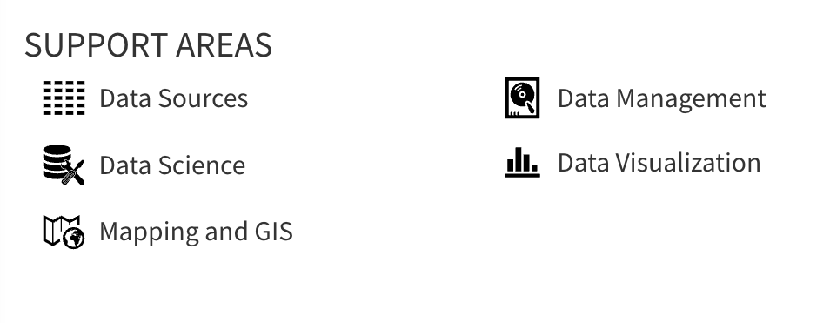
Center for Data & Visualization Sciences (CDVS)
AskData@duke.edu
Notes:
We offer workshops and individual consultation

Slide 4
“gg” in ggplot2 stands for “Grammar of Graphics”
Notes:
(move it over)

Slide 5
Data
Aesthetics
Geometries
Statistics
“gg” in ggplot2 stands for “Grammar of Graphics”
Graphics are built by layering elements
Scales
Themes
Notes:
(move it over)

Slide 6
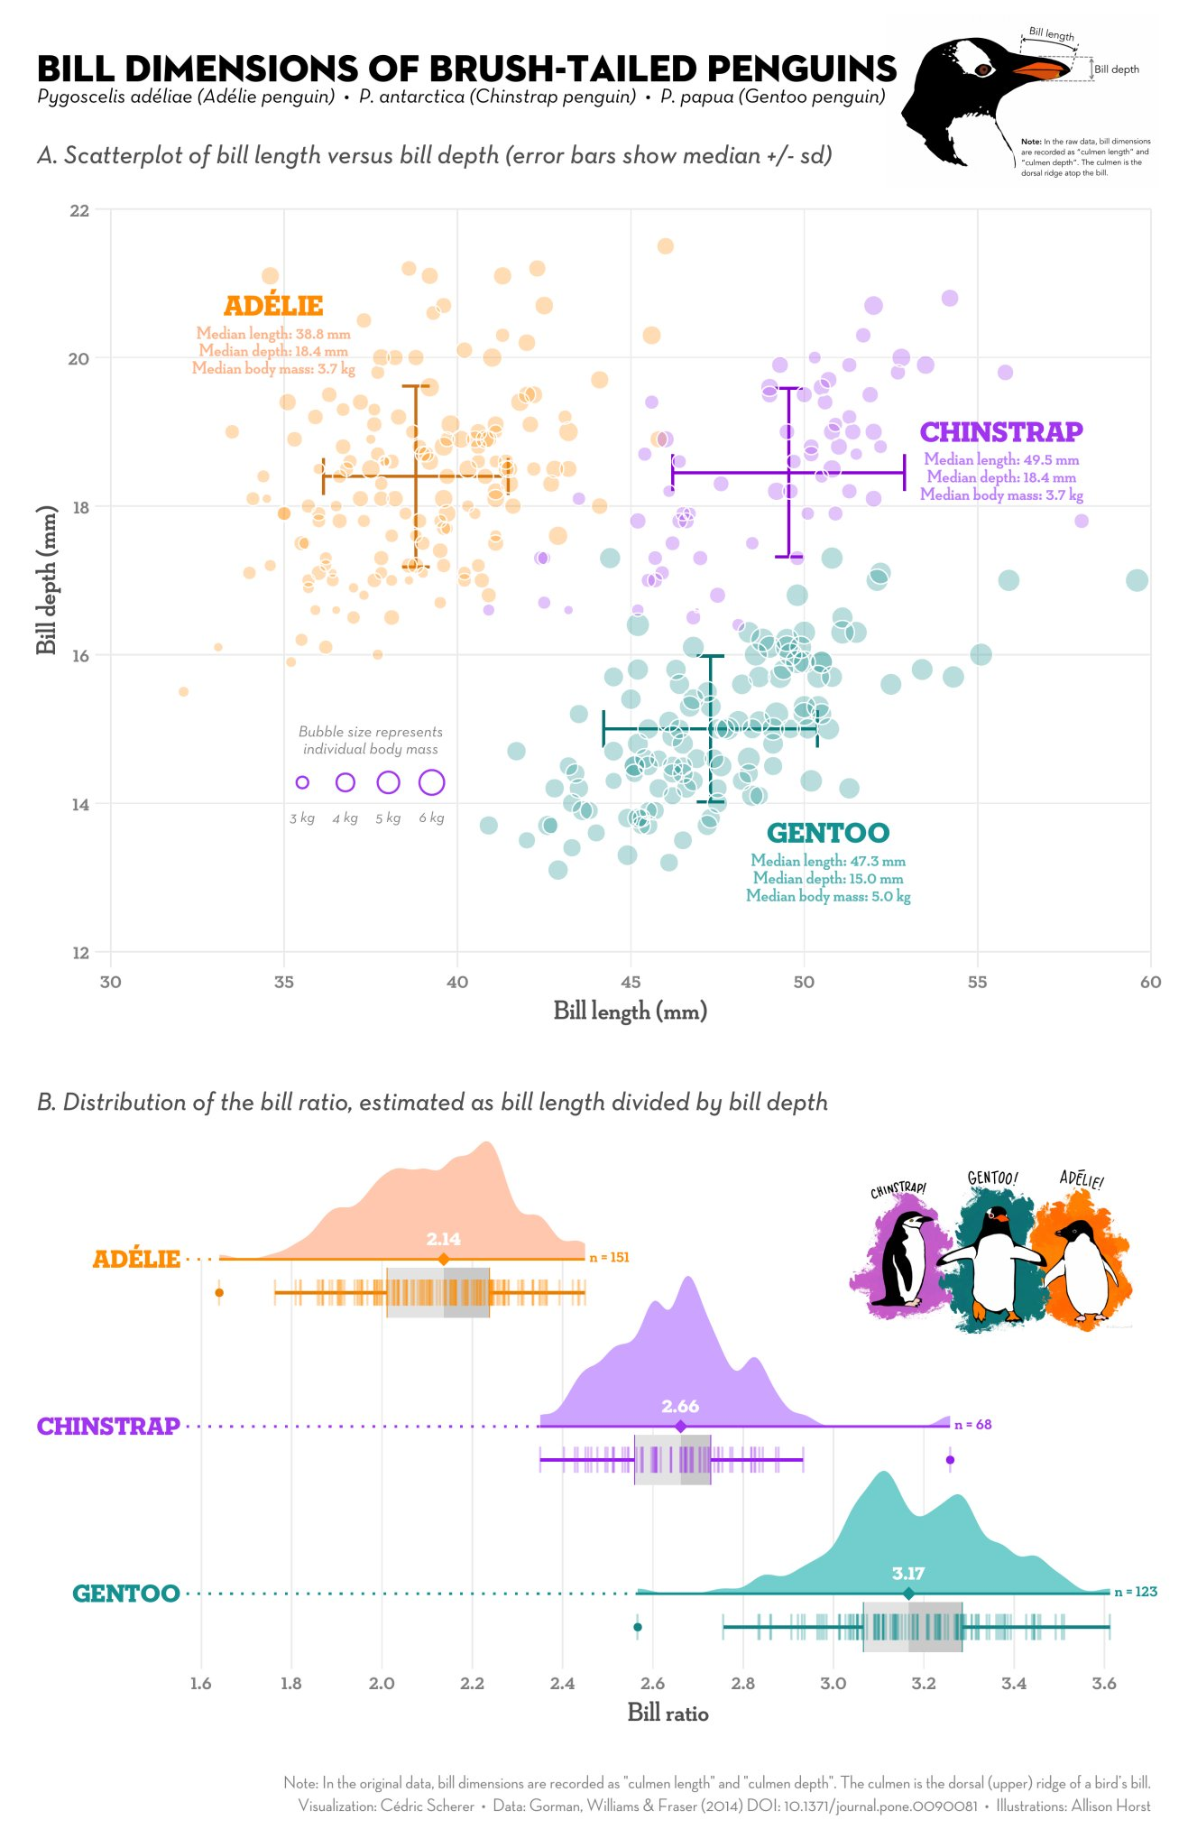
Notes:
Integration with analysis in R
Succinct
Versatile
Publication ready graphics
(or at least pretty close to it)

Slide 7
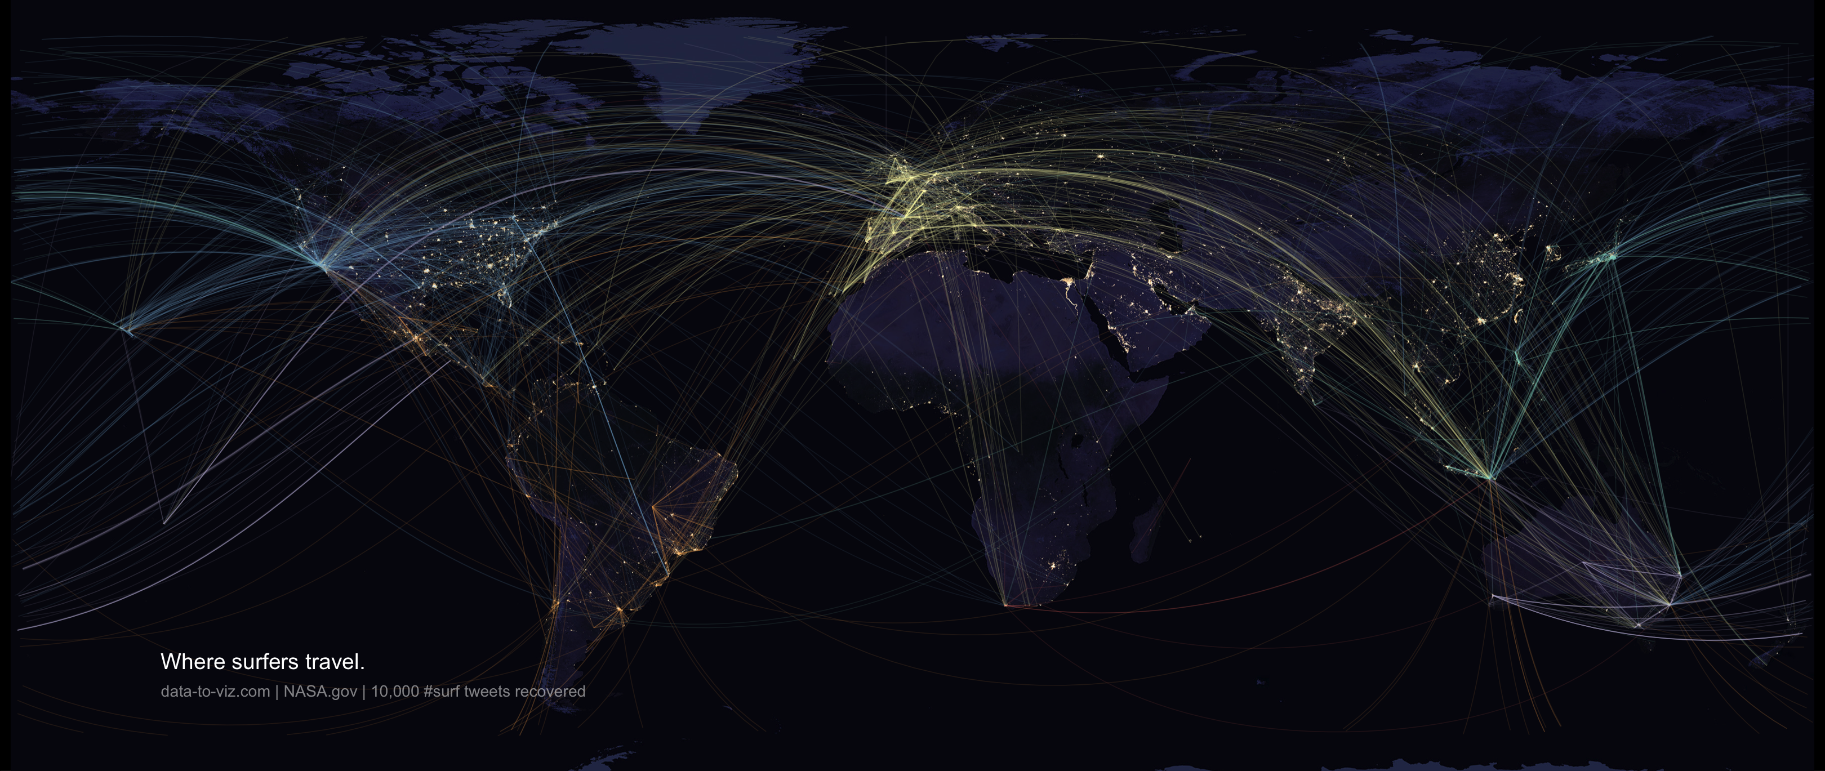
Notes:
Bespoke figures

Slide 8
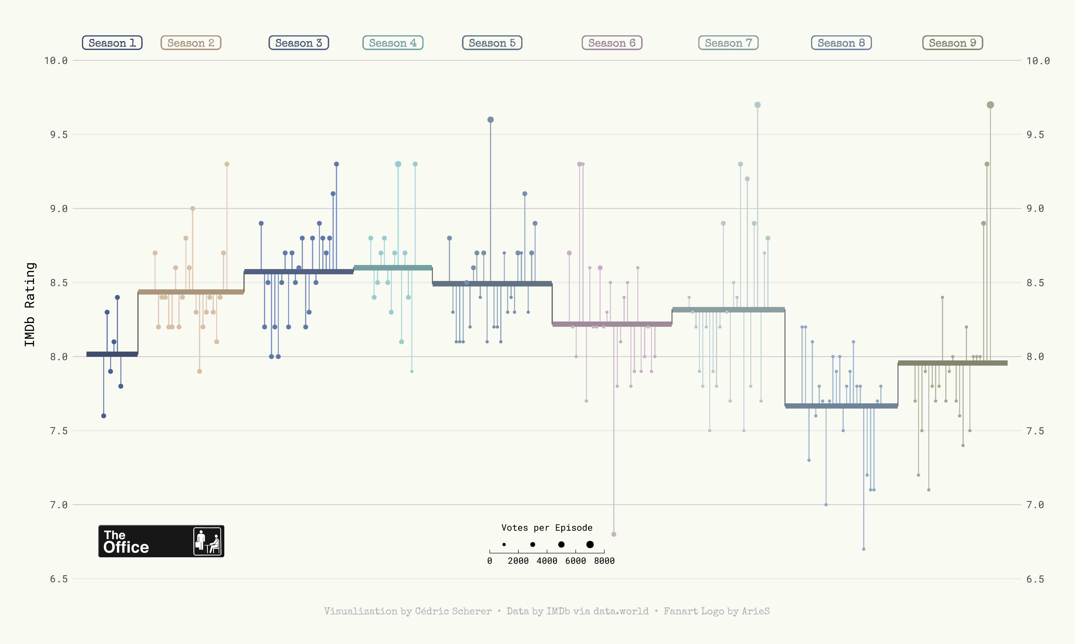

Slide 9
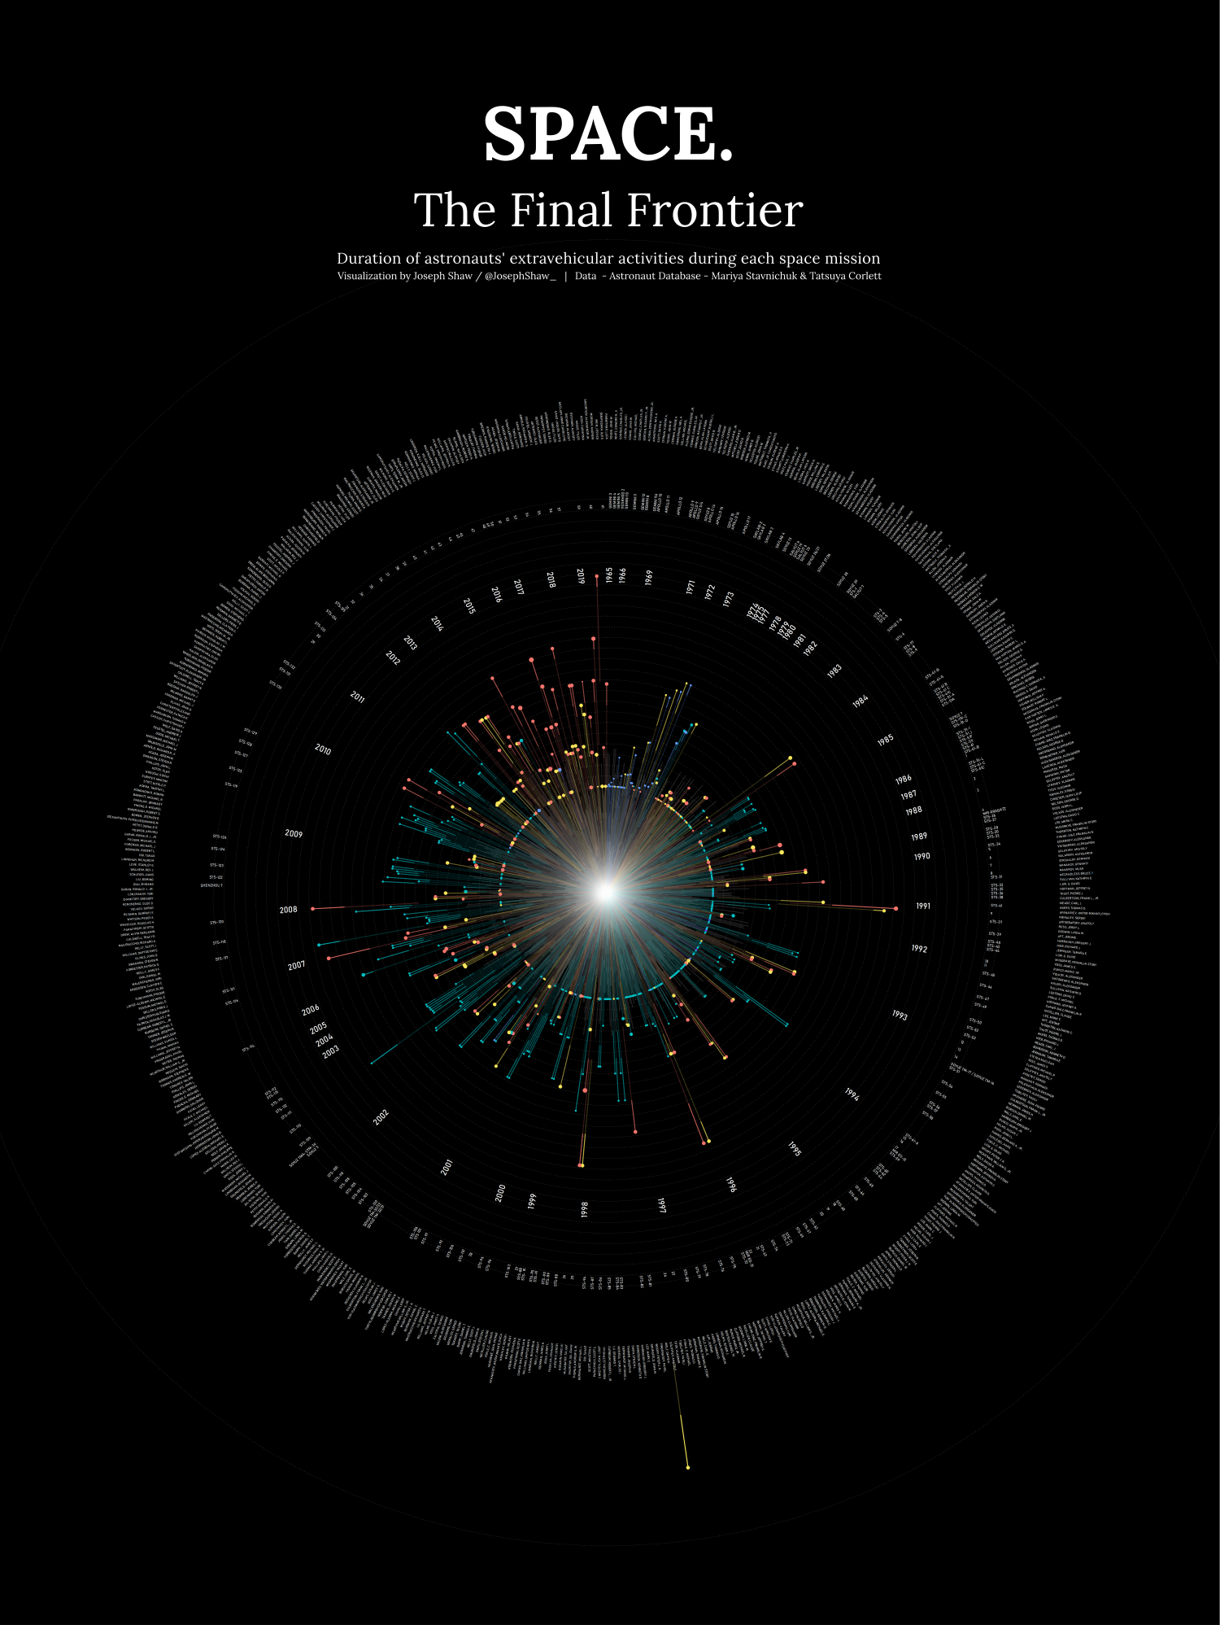
github.com/joseph-shaw/tidytuesday/

Slide 10
github.com/joseph-shaw/tidytuesday/

Slide 11
Data
ggplot(
data = yourdata
,
Mapping
mapping = aes(x axis, y axis)
) +
geometry function
+
Geometries
statistics function
+
Statistics
scales function
+
themes function
Scales
Themes
Notes:
method chaining with a +

Slide 12
Data
ggplot(
data = yourdata
,
Aesthetics
mapping = aes(x axis, y axis)
) +
geometry function
+
Geometries
statistics function
+
Statistics
scales function
+
themes function
Scales
Themes
Notes:
method chaining with a +

Slide 13
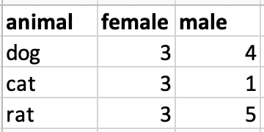
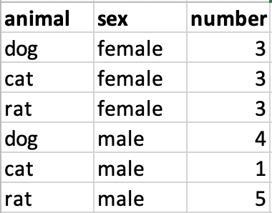
Data Format
Wide data
Long data

Slide 14
Data Format
Wide data
Long data
f

Slide 15
Data Format
Wide data
Long data
f
Wide_data = spread(Long_data, sex, number)

Slide 16
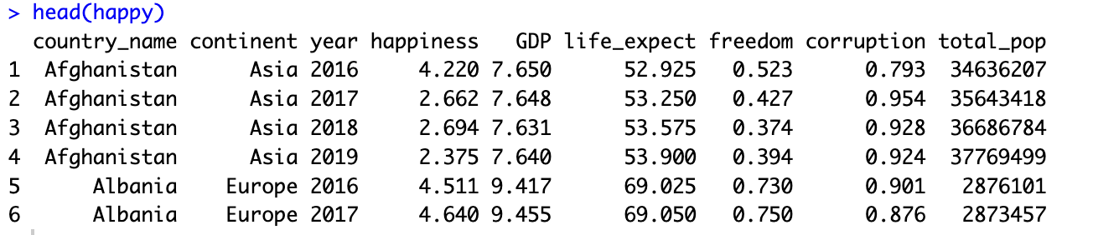

Slide 18
Data
,
) +
ggplot(
data = yourdata
,
aes(x axis, y axis)
Aesthetics
geometry function
Geometries
Notes:
method chaining with a +

Slide 19
Data
,
) +
ggplot(
data = yourdata
,
aes(x axis, y axis)
Aesthetics
geometry function
Geometries
ggplot(
data = happy
,
) +
aes(x=GDP, y=happiness)
geom_point()
Notes:
method chaining with a +

Slide 20
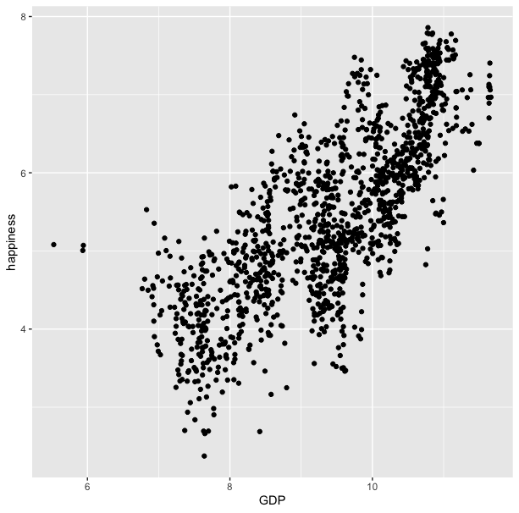
ggplot(
data = happy
,
) +
aes(x=GDP, y=happiness)
geom_point()

Slide 21
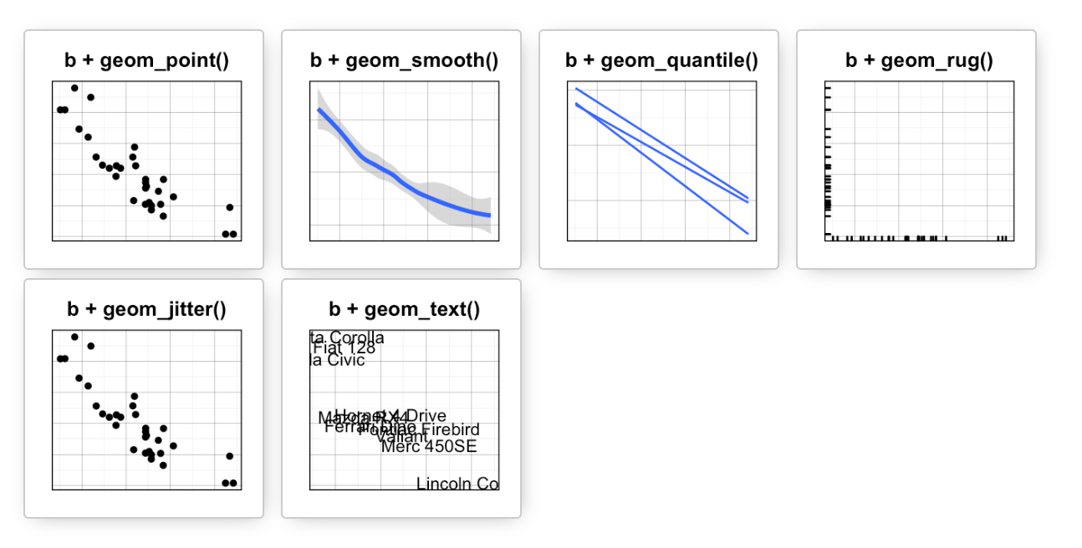
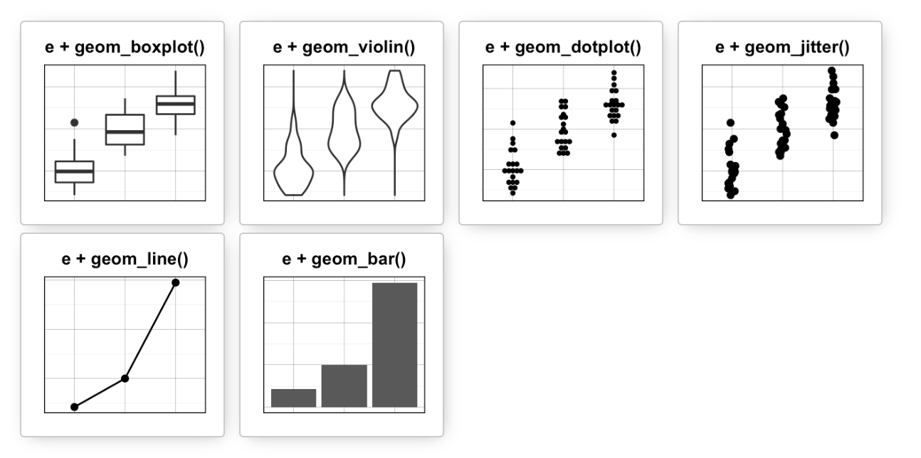
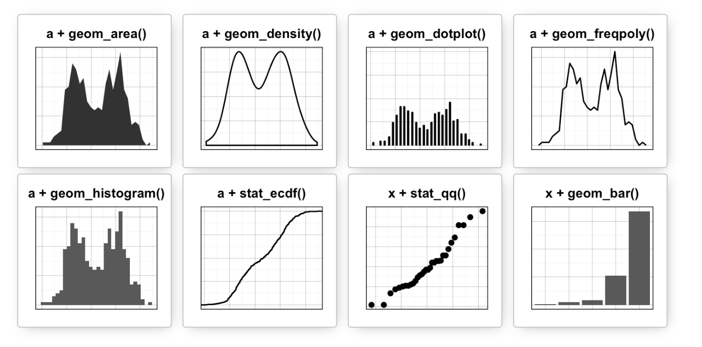
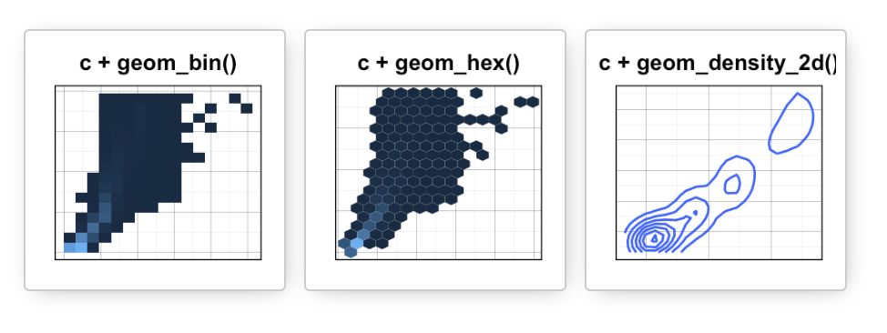
Data
Aesthetics
Geometries
Statistics
Scales
Themes
Exporting

Slide 22
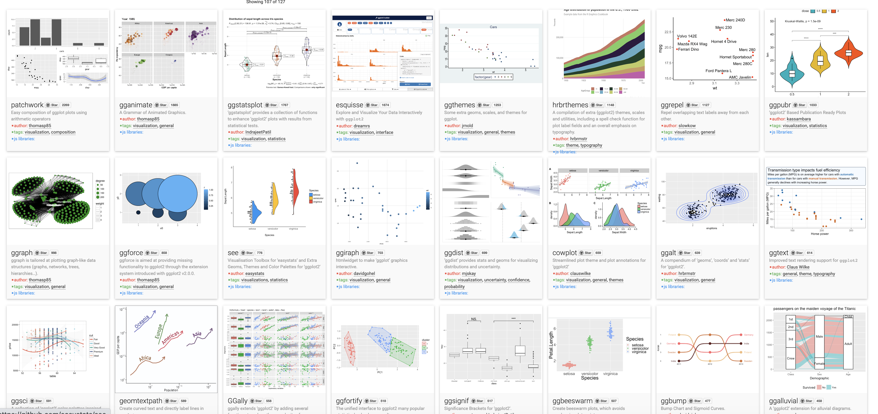
Over 120 ggplot2 extension libraries

Slide 23
ggplot(
,
data = happy
aes(GDP, happiness)
) +
geom_point()
“and then…”
dplyr %>% or |>
ggplot +

Slide 24
ggplot(data = happy, aes(x=GDP, y=happiness))+
geom_point()

Slide 25
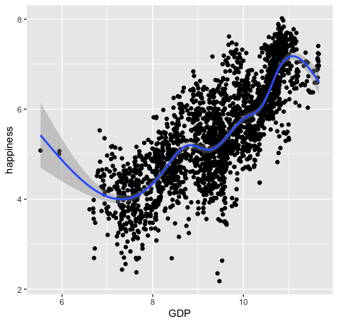
ggplot(data = happy, aes(x=GDP, y=happiness))+
geom_point()+
geom_smooth()

Slide 26
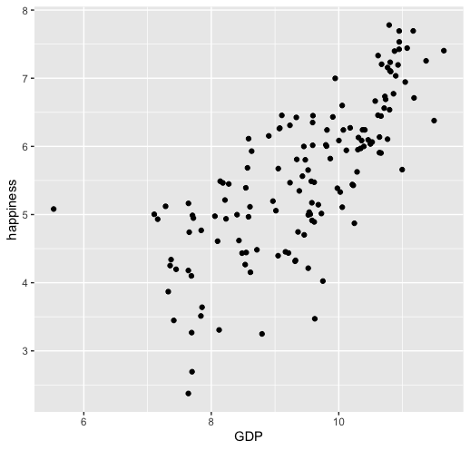
ggplot(
data = happy
,
) +
aes(x=GDP, y=happiness)
geom_point()

Slide 27
ggplot(
data = happy
,
aes(x=GDP, y=happiness)
) +
geom_point()
Notes:
ADD SLIDE BEF ORE WITHOUT Xs

Slide 28
ggplot(
data = happy
,
aes(x=GDP, y=happiness)
) +
geom_point()
ggplot(
happy
aes(GDP, happiness)
) +
,
geom_point()

Slide 29
ggplot(
data = happy
,
aes(x=GDP, y=happiness)
) +
geom_point()
ggplot(
happy
aes(GDP, happiness)
) +
,
geom_point()
ggplot(
) +
geom_point(
happy
aes(GDP, happiness)
,
)

Slide 30
ggplot(
data = happy
,
aes(x=GDP, y=happiness)
) +
geom_point()
ggplot(
happy
aes(GDP, happiness)
) +
,
geom_point()
ggplot(
) +
geom_point(
happy
aes(GDP, happiness)
,
)
,
happy
%>%
ggplot(
aes(GDP, happiness)
) +
geom_point()

Slide 31
ggplot(
data = happy
,
aes(x=GDP, y=happiness)
) +
geom_point()
ggplot(
happy
aes(GDP, happiness)
) +
,
geom_point()
ggplot(
) +
geom_point(
happy
aes(GDP, happiness)
,
)
,
happy
%>%
ggplot(
aes(GDP, happiness)
) +
geom_point()
These all produce the same figure!

Slide 32
Aesthetics define any data that gets mapped to geometry
(such as color, size, shape, etc.)
ggplot(data = yourData,
aes(x = xaxis,y = yaxis))+
geom_point()
Notes:
method chaining with a +

Slide 33
Aesthetics define any data that gets mapped to geometry
(such as color, size, shape, etc.)
ggplot(data = happy,
aes(x = happiness,y = GDP,
shape= ,
size= ,
col= ))+
geom_point()
Notes:
method chaining with a +

Slide 35
ggplot(happy, aes(GDP, happiness)) +
geom_point()

Slide 36
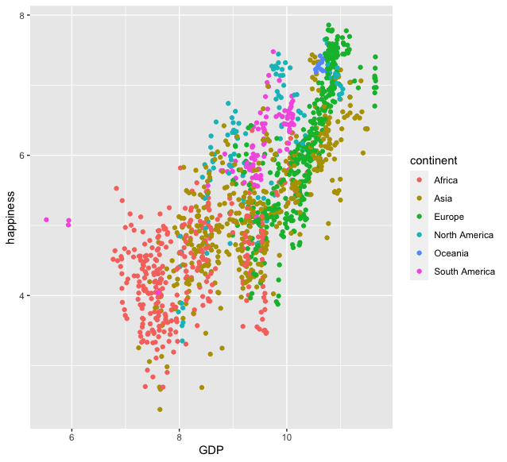
ggplot(happy, aes(GDP, happiness)) +
geom_point(aes(col=continent))

Slide 37
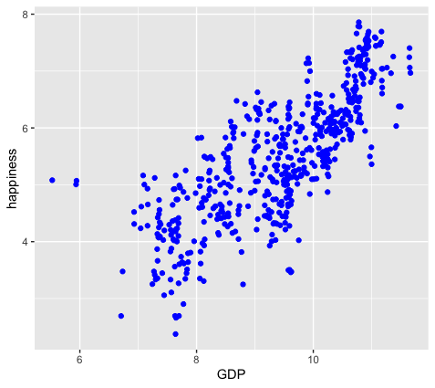
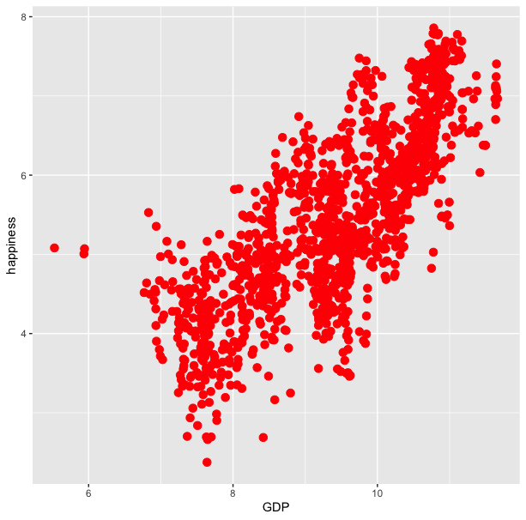
ggplot(happy, aes(GDP, happiness)) +
geom_point(aes(col=continent))
ggplot(happy, aes(GDP, happiness)) +
geom_point(col=‘blue’)

Slide 38
ggplot(happy, aes(GDP, happiness)) +
geom_point(aes(col=continent))
ggplot(happy, aes(GDP, happiness)) +
geom_point(col=‘blue’)
ggplot(happy, aes(GDP, happiness)) +
geom_point(aes(col=‘blue’))

Slide 39
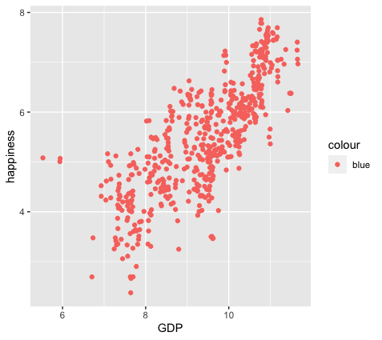
ggplot(happy, aes(GDP, happiness)) +
geom_point(aes(col=continent))
ggplot(happy, aes(GDP, happiness)) +
geom_point(col=‘blue’)
ggplot(happy, aes(GDP, happiness)) +
geom_point(aes(col=‘blue’))

Slide 40
colour
blue
blue
blue
blue
blue
blue
ggplot(happy, aes(GDP, happiness)) +
geom_point(aes(col=‘blue’))

Slide 41
ggplot(happy, aes(GDP, happiness)) +
geom_point()
We can also set conditional formatting.
e.g. Use different colors for points where happiness is > 5

Slide 42
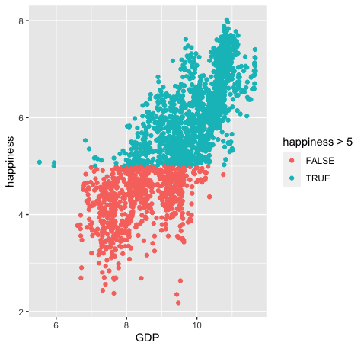
ggplot(happy, aes(GDP, happiness)) +
geom_point()
ggplot(happy, aes(GDP, happiness)) +
geom_point(aes(col=happiness > 5)

Slide 43
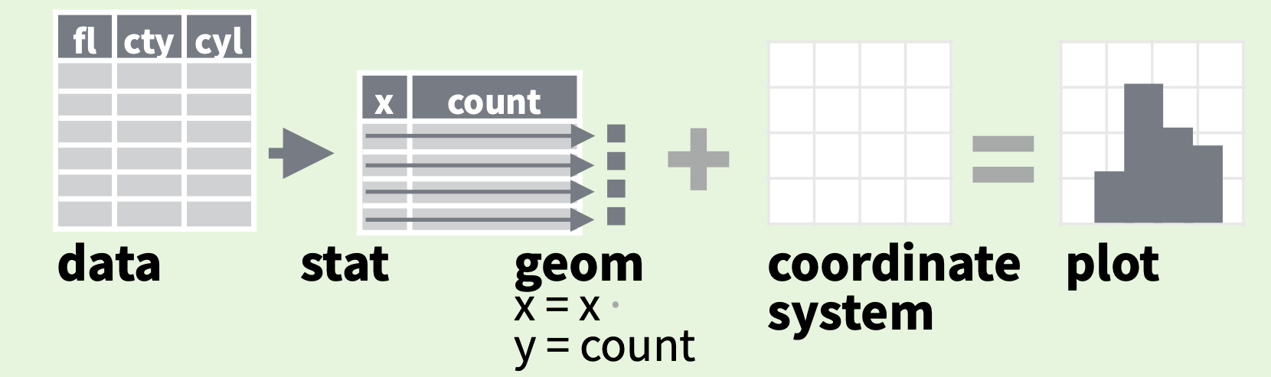
stats
Every geom function specifies a stat
Data
Aesthetics
Geometries
Statistics
Scales
Themes
Exporting

Slide 44
stats
Every geom function specifies a stat
Notes:
For example: If we wanted to make a bar plot that shows how frequently each of the continents is represented in our dataset.

Slide 45
stats
Every geom function specifies a stat
ggplot(happy, aes(continent)) +
geom_bar()
Notes:
ADD INFO ABOUT THE SILENT STAT=SUM

Slide 46
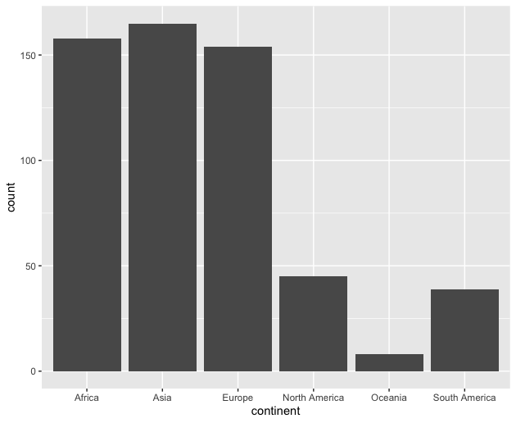
stats
Every geom function specifies a stat
ggplot(happy, aes(continent)) +
geom_bar()

Slide 47
Scales
Data
Scales permeate all aspects of plotting in ggplot2
Most defaults will be enough
BUT learning how to manipulate them will give you much more control.
Aesthetics
Geometries
Statistics
Scales
Themes
Exporting

Slide 48
Scales
Data
Scales permeate all aspects of plotting in ggplot2
Most defaults will be enough
BUT learning how to manipulate them will give you much more control.
Aesthetics
Geometries
Statistics
Scales
Themes
Exporting

Slide 49
Scales
Data
Scales permeate all aspects of plotting in ggplot2
Most defaults will be enough
BUT learning how to manipulate them will give you much more control.
Aesthetics
Geometries
Statistics
Scales
Themes
Exporting

Slide 50
Three kinds of scales you are most likely to use:
Axes Limits
Bins
Colors

Slide 51
Three kinds of scales you are most likely to use:
Axes Limits
Bins
Colors
Ill cover these during the live demo portion

Slide 52
Three kinds of scales you are most likely to use:
Axes Limits
Bins
Colors
I want to spend some time talking about color scales

Slide 53
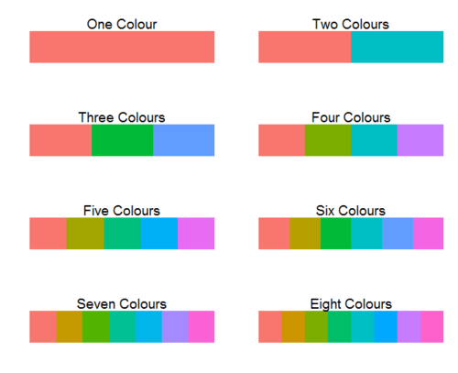
ggplot2 default colors for factors

Slide 54
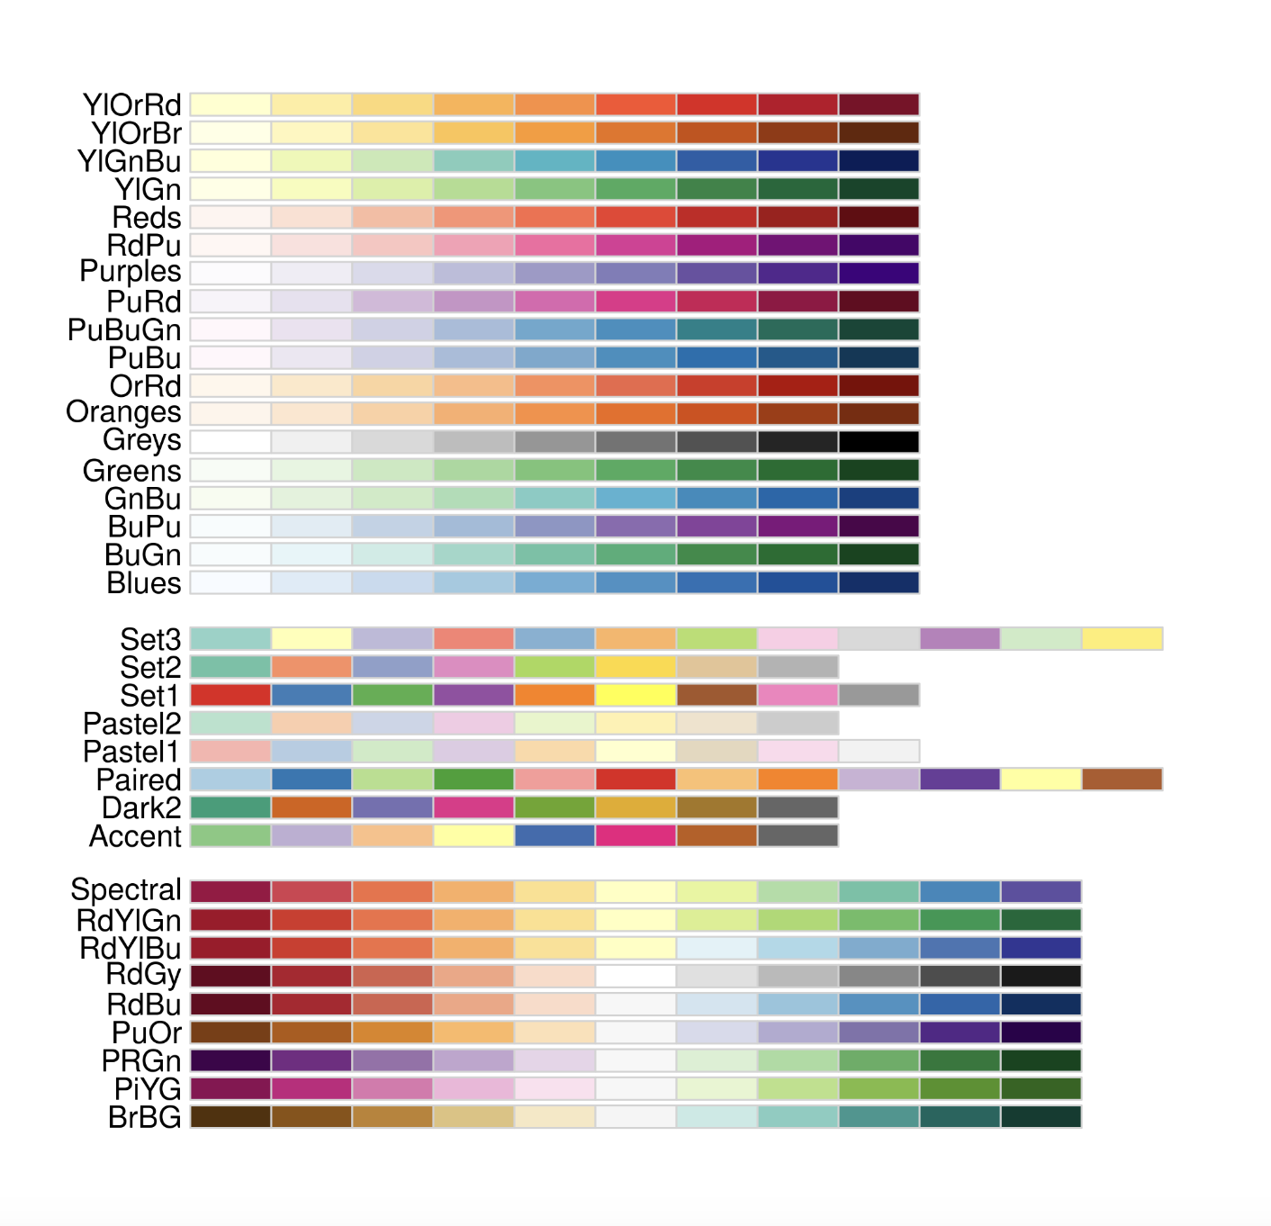
Brewer Scales
Monochrome scales
Qualitative scales
Divergent color scales
Notes:
ADD IMAGE OF DEFAULT COLOR SCALE

Slide 55
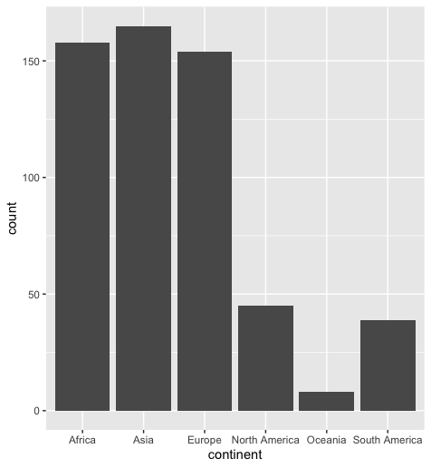
Brewer Scales
ggplot(happy, aes(GDP, happiness))+
geom_bar()
Notes:
take out col=continent

Slide 56
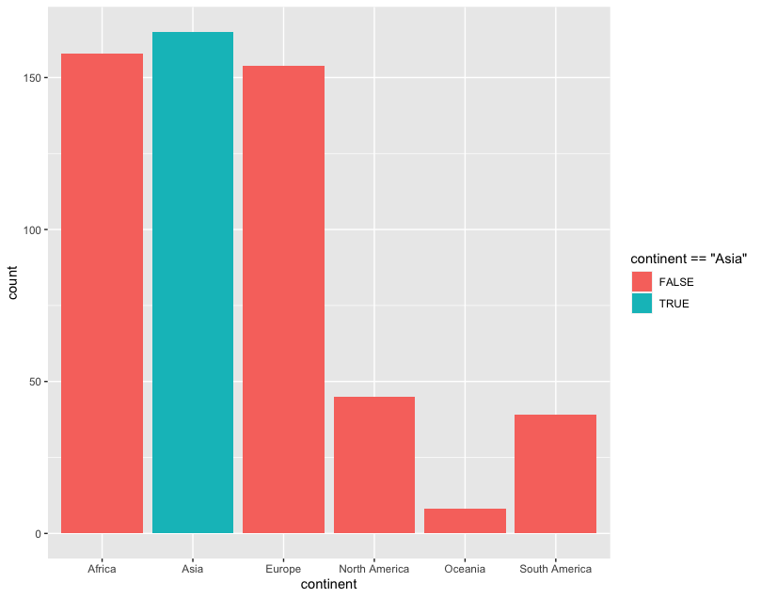
Brewer Scales
ggplot(happy, aes(GDP, happiness))+
geom_bar(aes(fill=continent==‘Asia’))
Notes:
Take

Slide 57
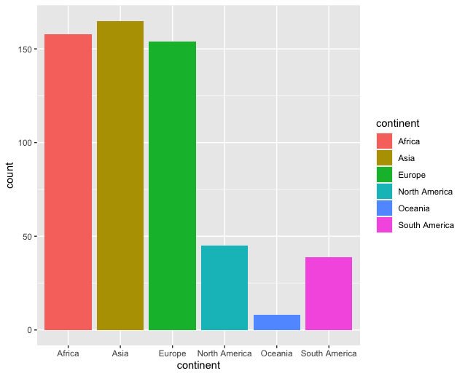
Brewer Scales
ggplot(happy, aes(GDP, happiness))+
geom_bar(aes(fill=continent==‘Asia’))
Notes:
USE A DIFFERENT EXAMPLE USING A HIGHLIGHT COLOR

Slide 58
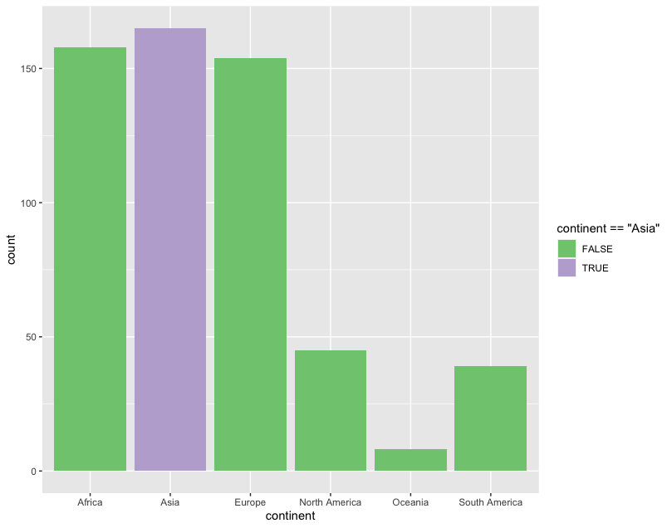
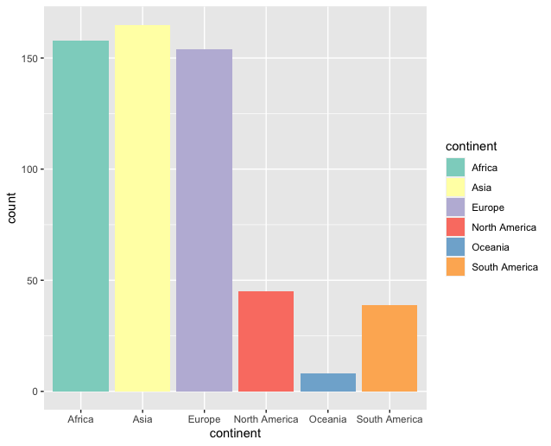
Brewer Scales
ggplot(happy, aes(GDP, happiness))+
geom_bar(aes(col=continent==‘Asia’))+
scale_fill_brewer(palette = “Accent”)

Slide 59

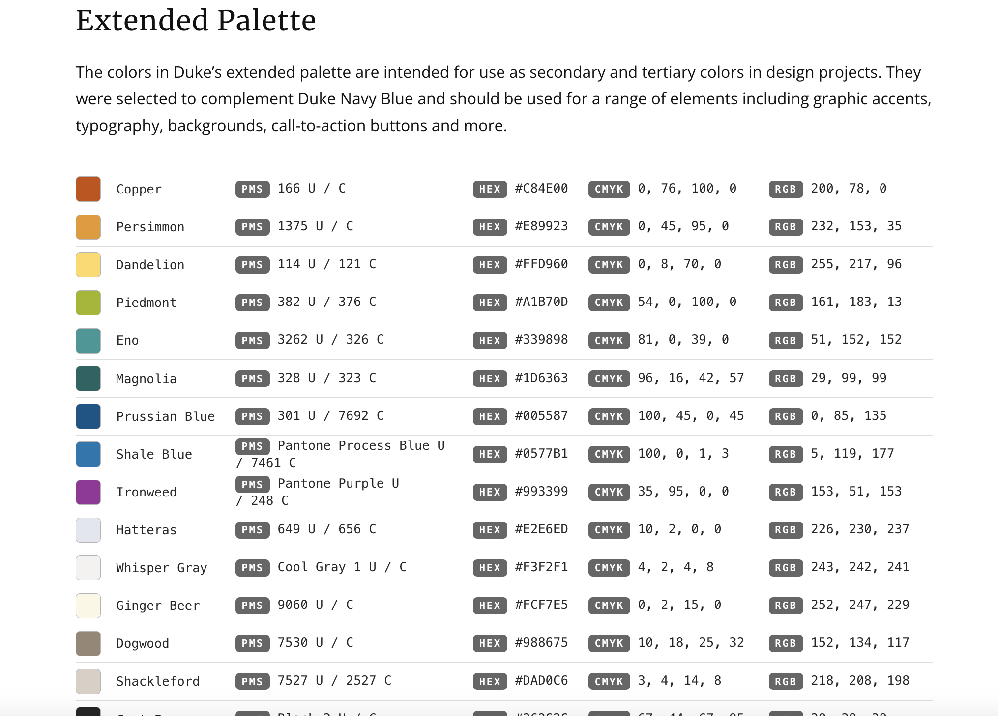
http://brand.duke.edu/colors

Slide 60

http://brand.duke.edu/colors

Slide 61
Custom Scales
Notes:
USE A DIFFERENT EXAMPLE. Add slides showing how you can use neutral and highlight colors

Slide 62
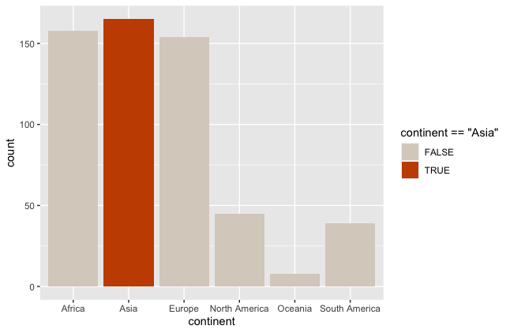
Custom Scales
ggplot(happy, aes(GDP, happiness))+
geom_bar(aes(col=continent==‘Asia’))+
scale_fill_manual(value = DukeColors)
Notes:
USE A DIFFERENT EXAMPLE. Add slides showing how you can use neutral and highlight colors

Slide 63
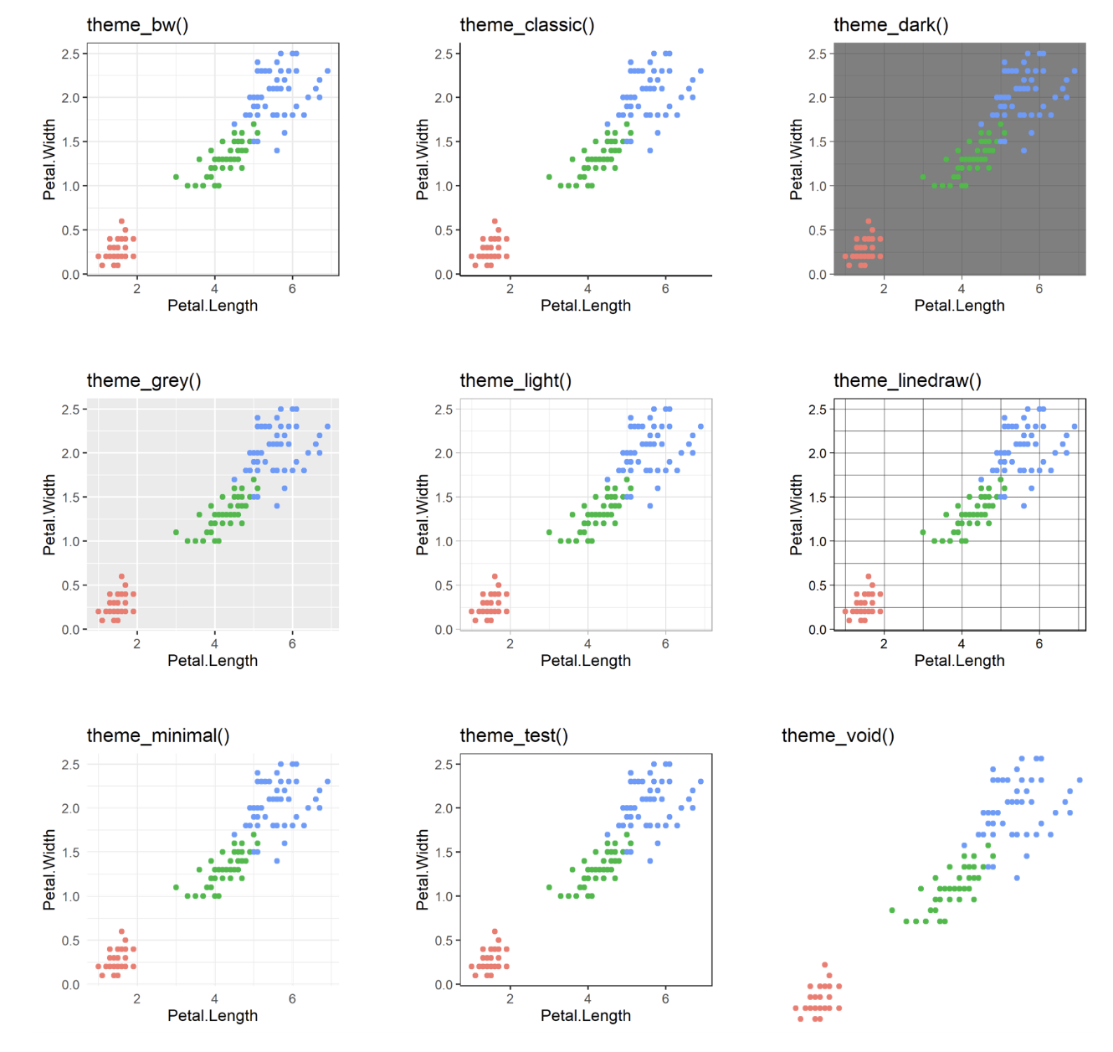
60 preexisting themes
easy to call
Data
Aesthetics
Geometries
Statistics
Scales
Themes
Exporting

Slide 64
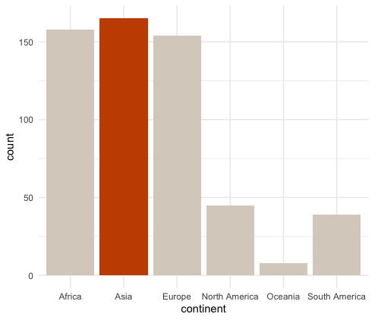
ggplot(happy, aes(GDP, happiness))+ geom_bar(aes(col=continent==‘Asia’))+
scale_fill_manual(value = DukeColors)
ggplot(happy, aes(GDP, happiness))+ geom_bar(aes(col=continent==‘Asia’))+
scale_fill_manual(value = DukeColors)+
theme_minimal()

Slide 65
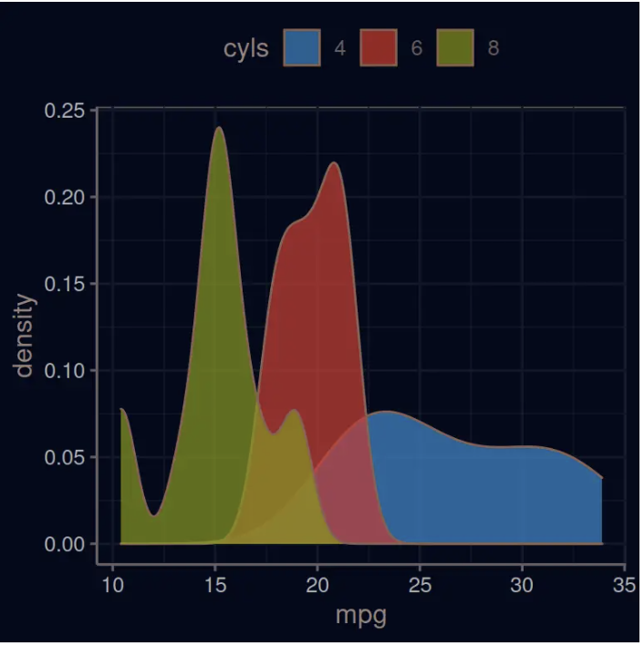
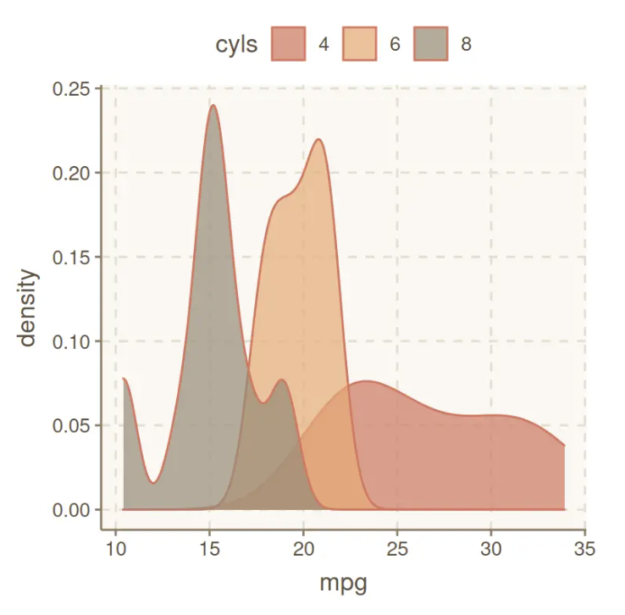
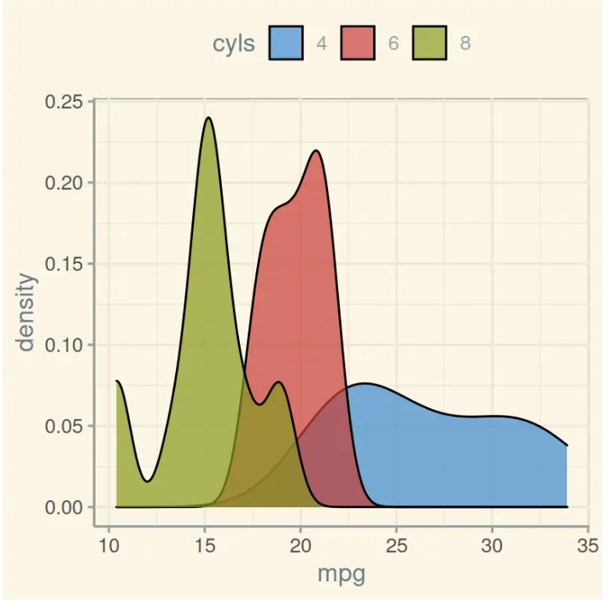
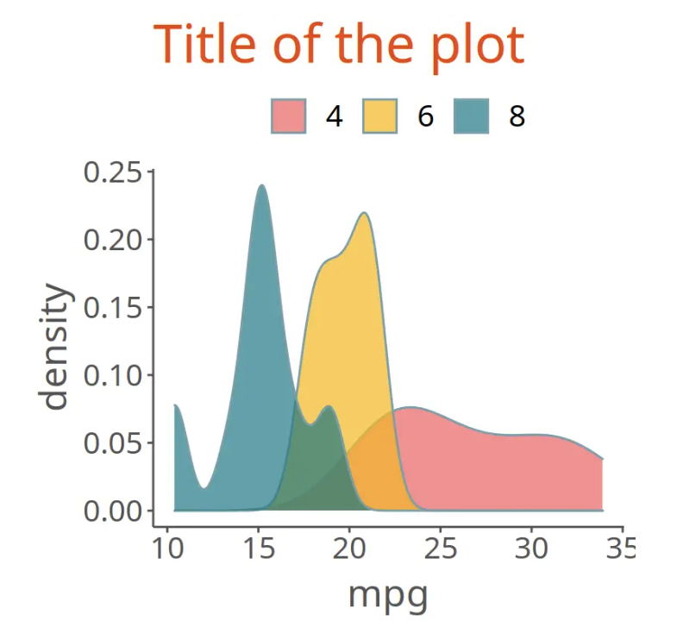
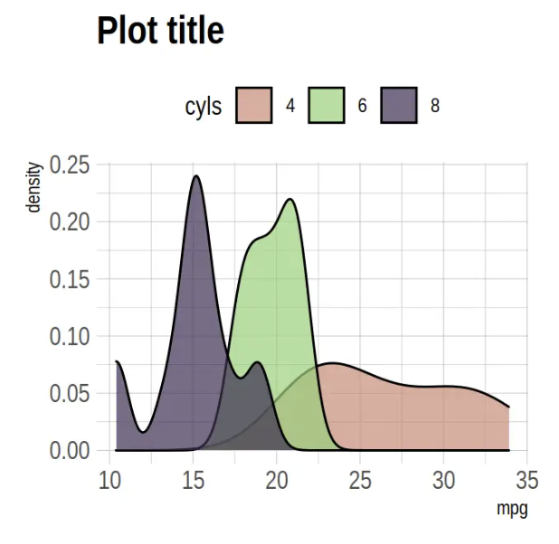
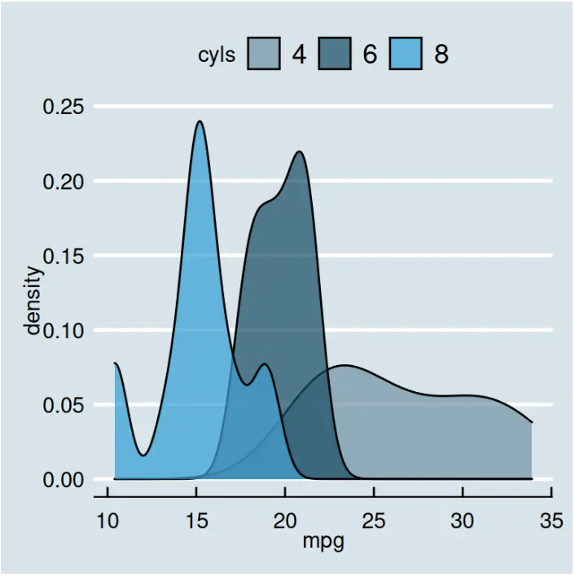
Over 60 pre-existing themes
Data
Aesthetics
Geometries
Statistics
Scales
Themes
Exporting
https://r-charts.com/ggplot2/themes/

Slide 66
60 preexisting themes
easy to call
Data
Aesthetics
Geometries
Statistics
Scales
Themes
Exporting

Slide 67
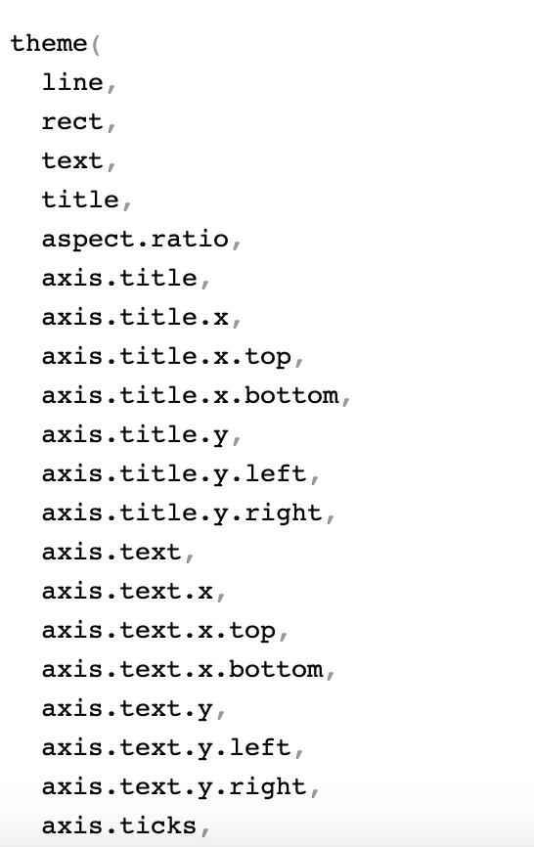
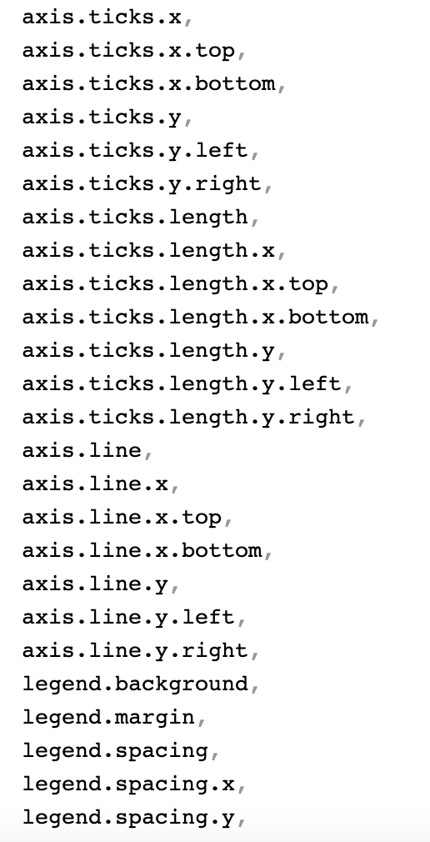
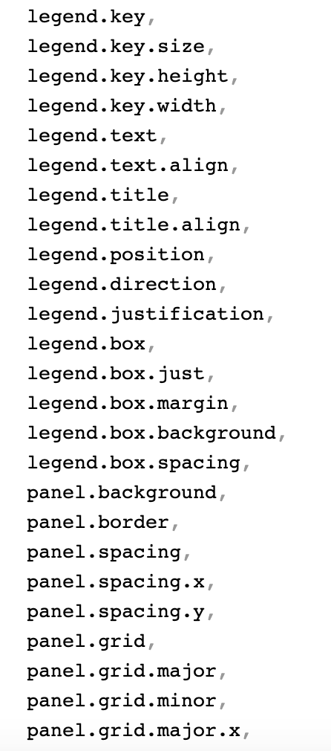
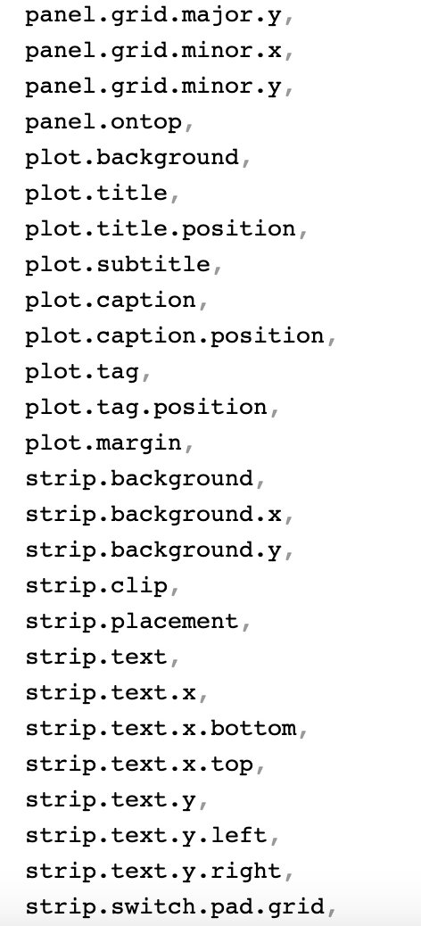
?theme()
…

Slide 68
ggplot(happy, aes(GDP, happiness))+ geom_bar(aes(col=continent==‘Asia’))+
scale_fill_manual(value = DukeColors)+
theme_minimal()

Slide 69
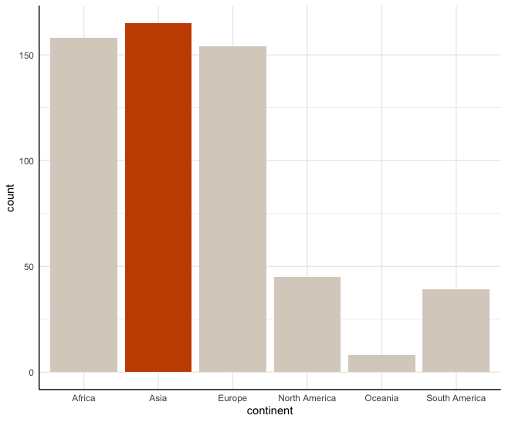
ggplot(happy, aes(GDP, happiness))+ geom_bar(aes(col=continent==‘Asia’))+
scale_fill_manual(value = DukeColors)+
theme_minimal()+
theme(axis.line.x.bottom=element_line(),
axis.line.y.left=element_line()

Slide 70
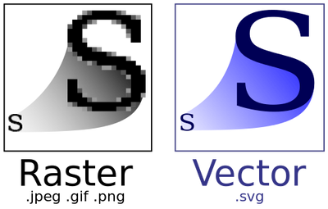
Data
Aesthetics
Geometries
Statistics
Scales
.pdf
Themes
Exporting

Slide 71
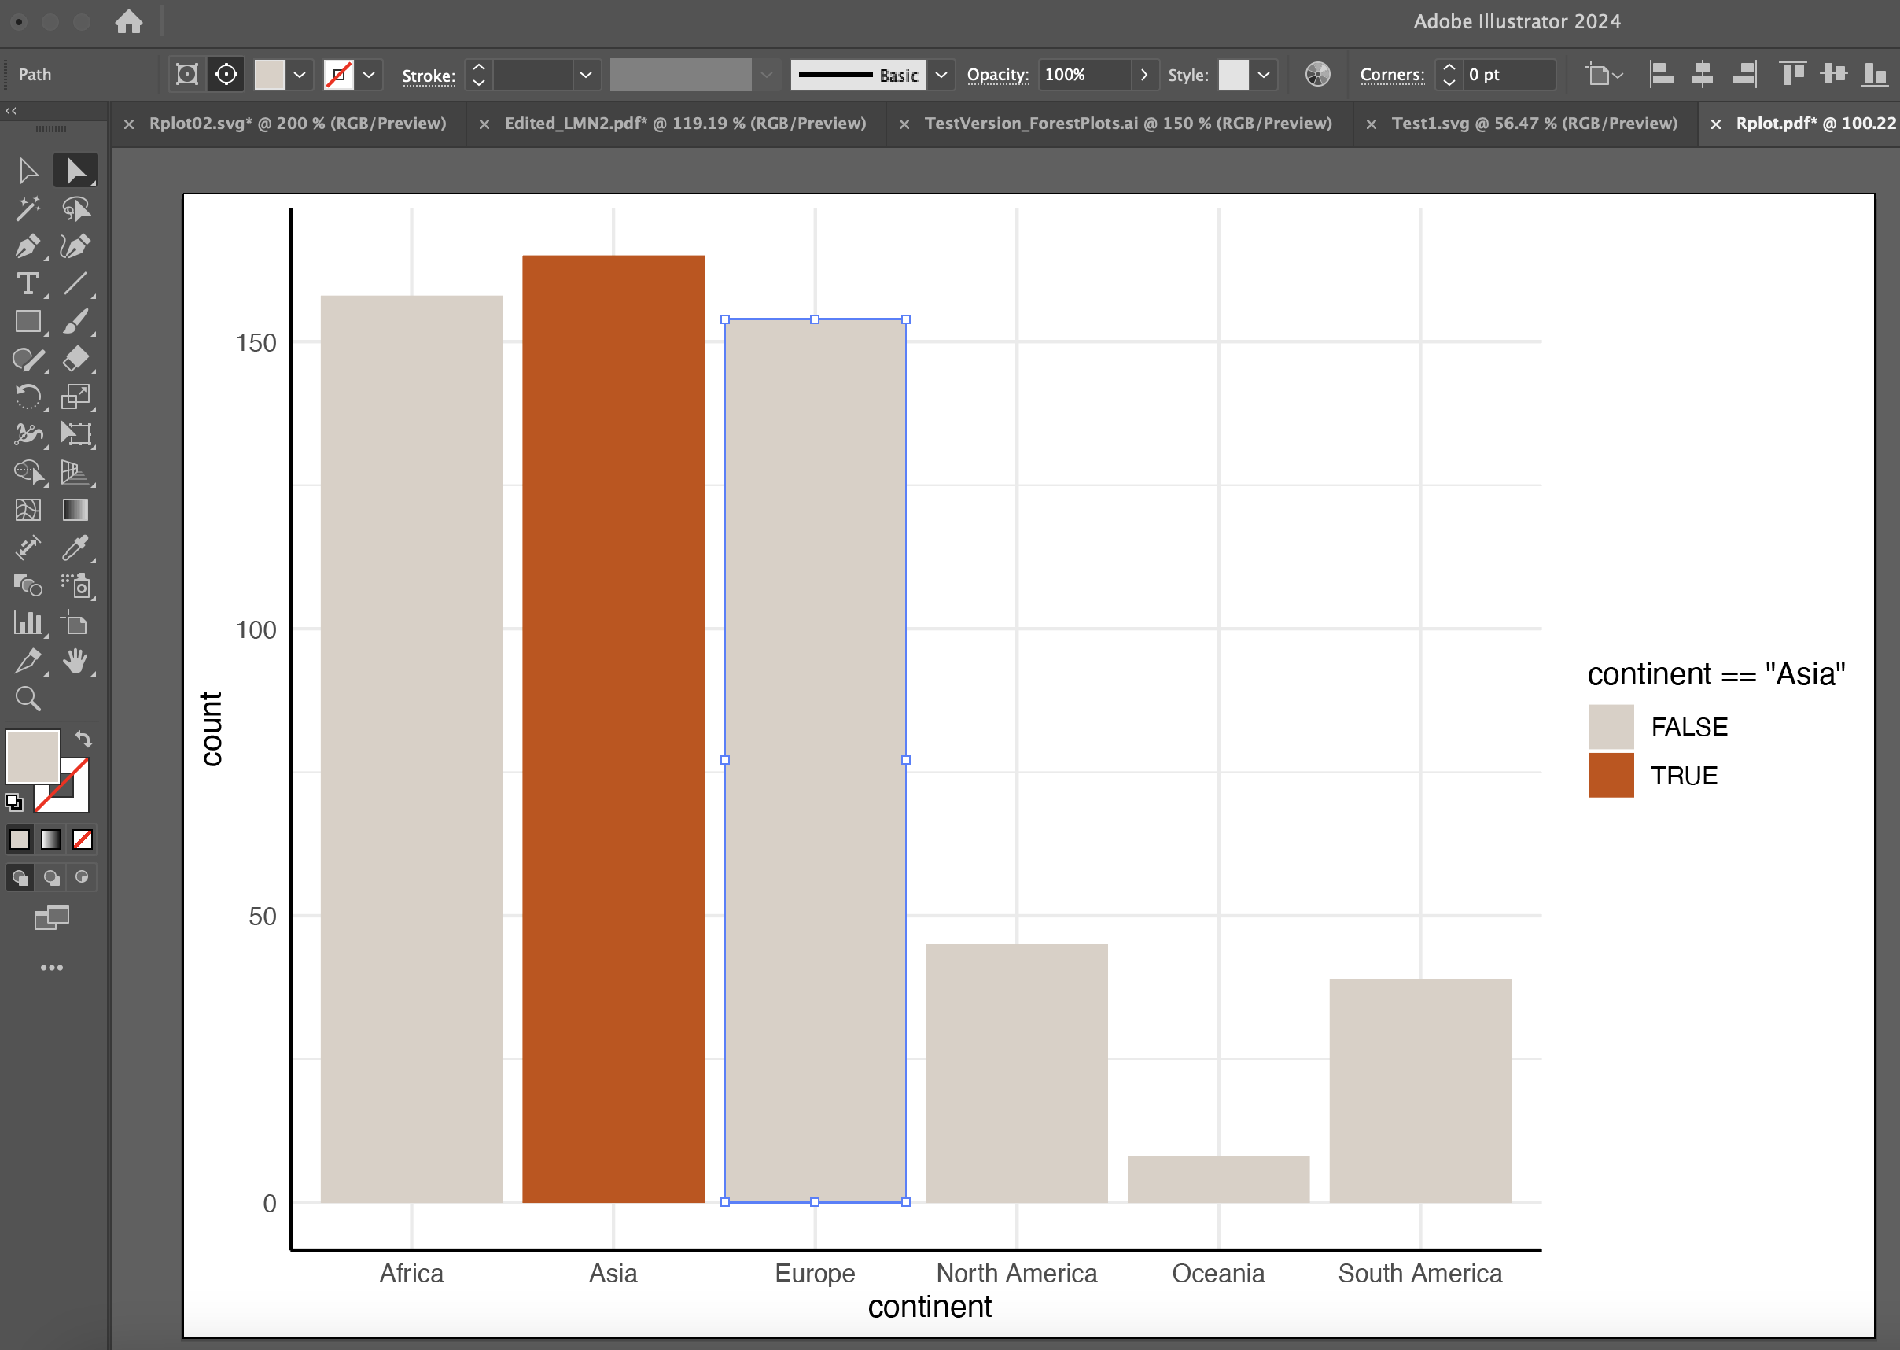

Slide 72
Lets give it a try
github.com/laurennichols/ggplot2_workshop

